Slide 1
Hope Artificial Intelligence
AI-Powered Customer Retention Prediction
Objective:
This dataset contains customer information from a bank, including demographic, financial, and account-related details. It is used to analyze customer behavior and predict whether a customer is likely to leave the bank (churn) or continue using its services. The goal is to help improve customer retention using AI and machine learning techniques.
The project was carried out in five main stages. The data was cleaned and preprocessed by handling unnecessary columns and converting categorical data into numerical form. Exploratory Data Analysis (EDA) was performed to understand patterns and relationships in the data. Important features were selected, and multiple machine learning models were built and evaluated to find the best-performing model. Finally, the Random Forest model was chosen and deployed by saving it along with the scaler and feature structure to make predictions on new customer data.
A web application was developed using Django to provide an interface for users to input customer details and view predictions. The trained AI model is integrated into the backend using pickle files to generate real-time results. This allows users to easily check whether a customer is likely to stay or leave through a user-friendly interface.

Slide 2
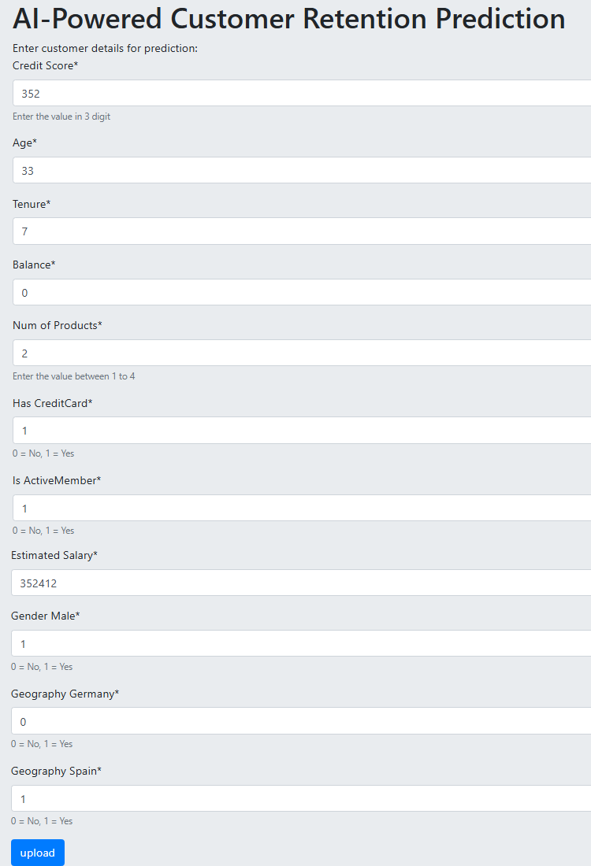

Slide 3
